Slide 1
Implementing a Dynamic Branch Predictor Using a Perceptron Learning Algorithm

Slide 2
Group – 05
Urmi Kirtonia 2022-1-60-184
Shanta Islam 2022-1-60-288
Md Sifat ullah Sheikh 2022-1-60-029
Instructor: Dr. Md. Nawab Yousuf Ali
Professor Department of Computer Science & Engineering

Slide 3
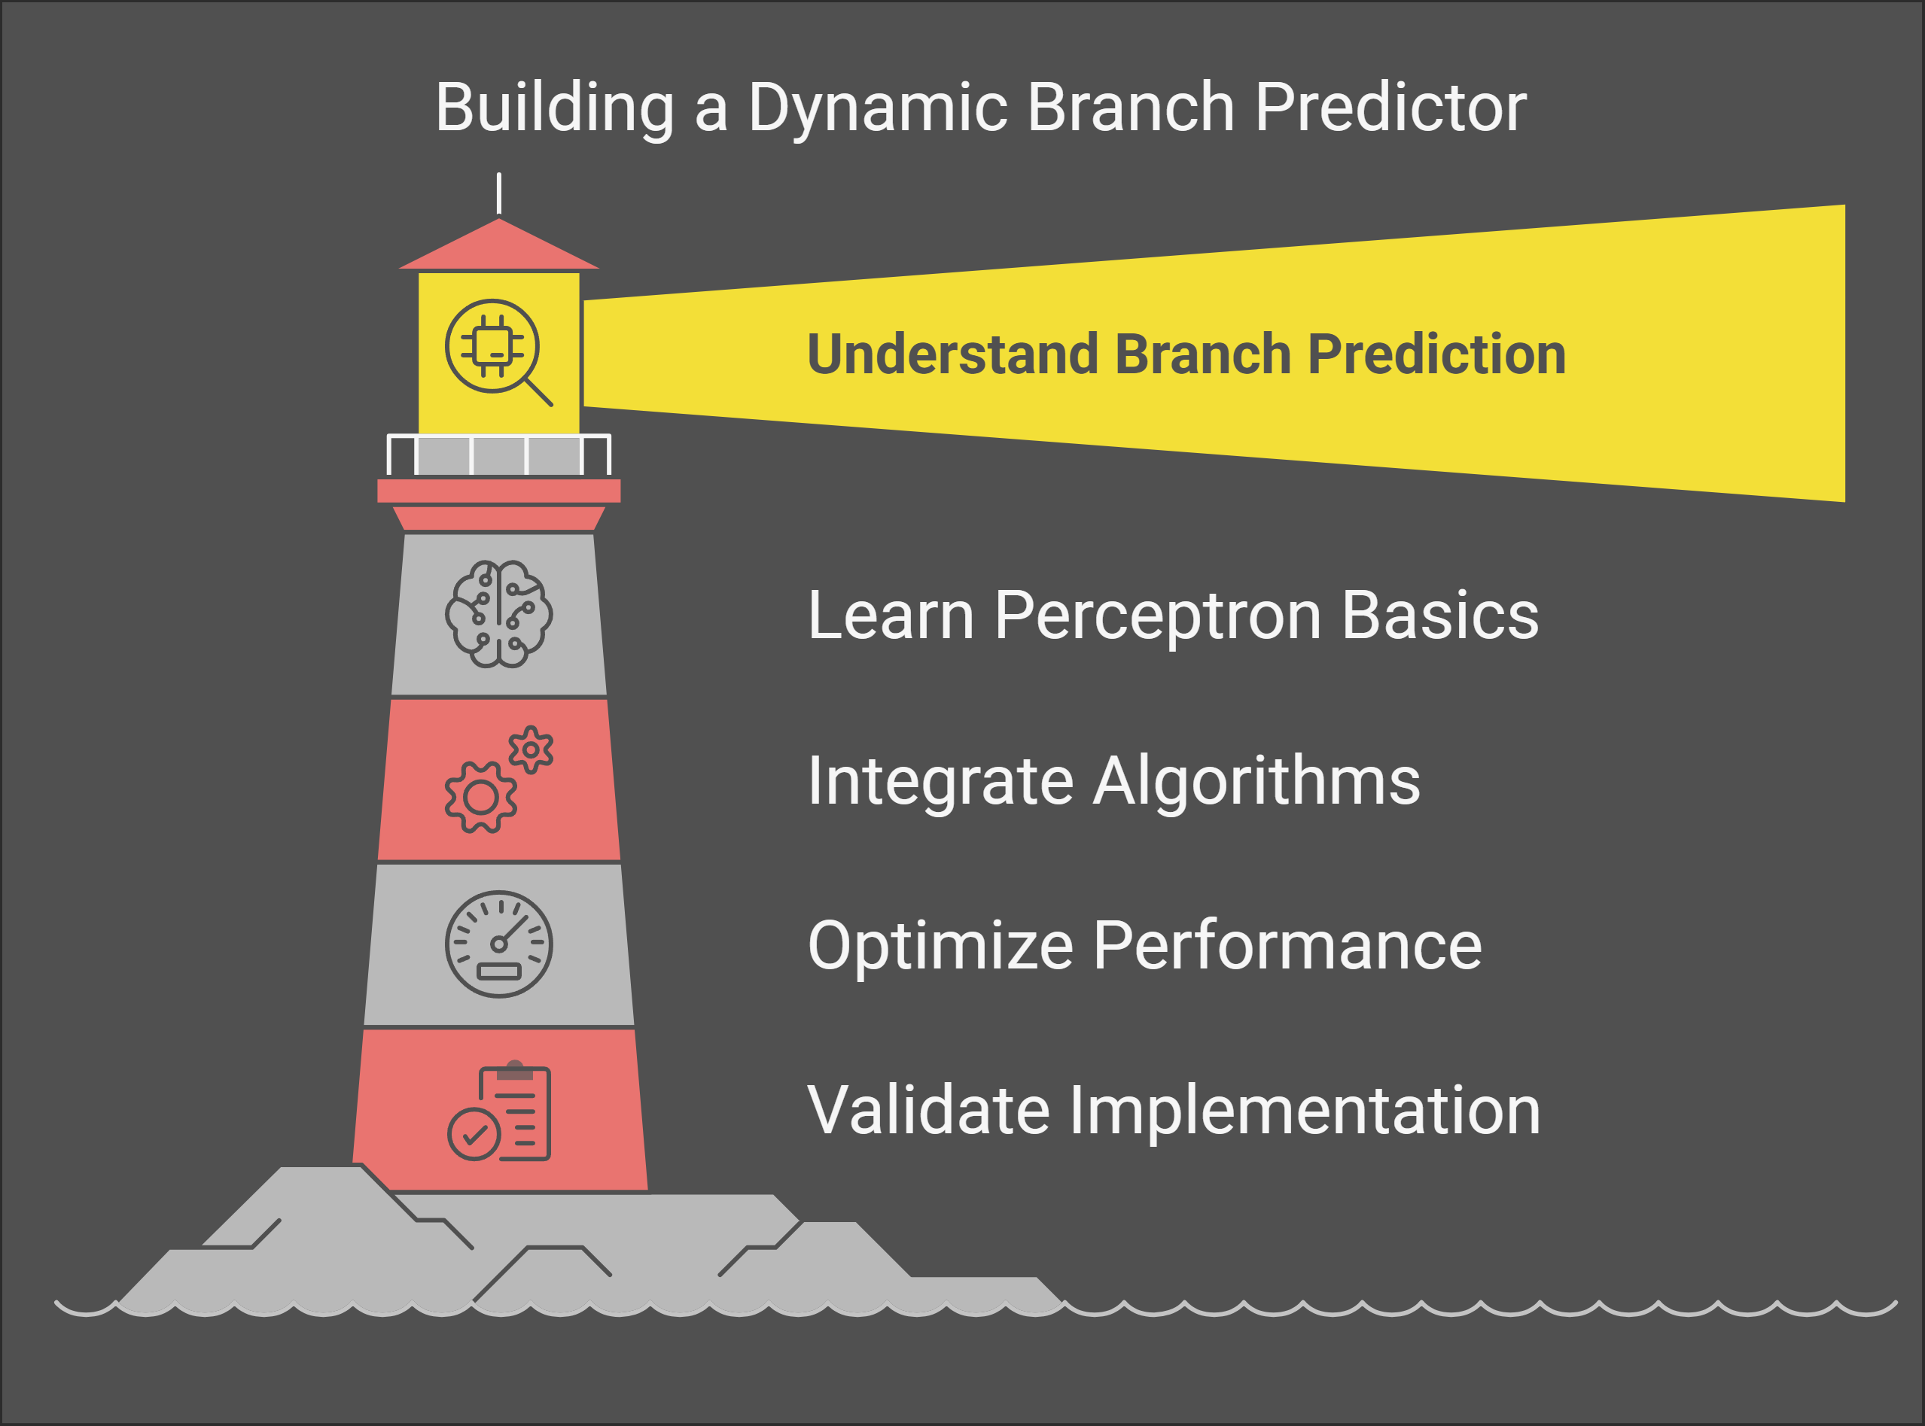
KEY POINTS :

Slide 4
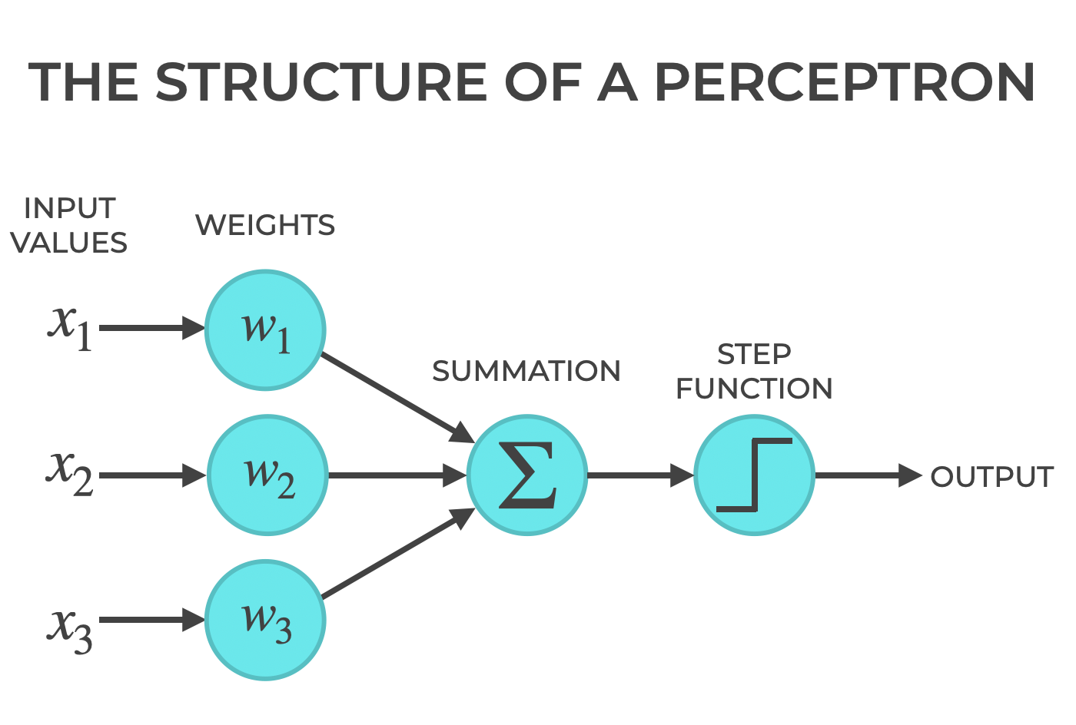
What is perceptron?
It is based on real-life biological neurons, making it a binary classifier.
A perceptron is a type of artificial neural network.

Slide 5
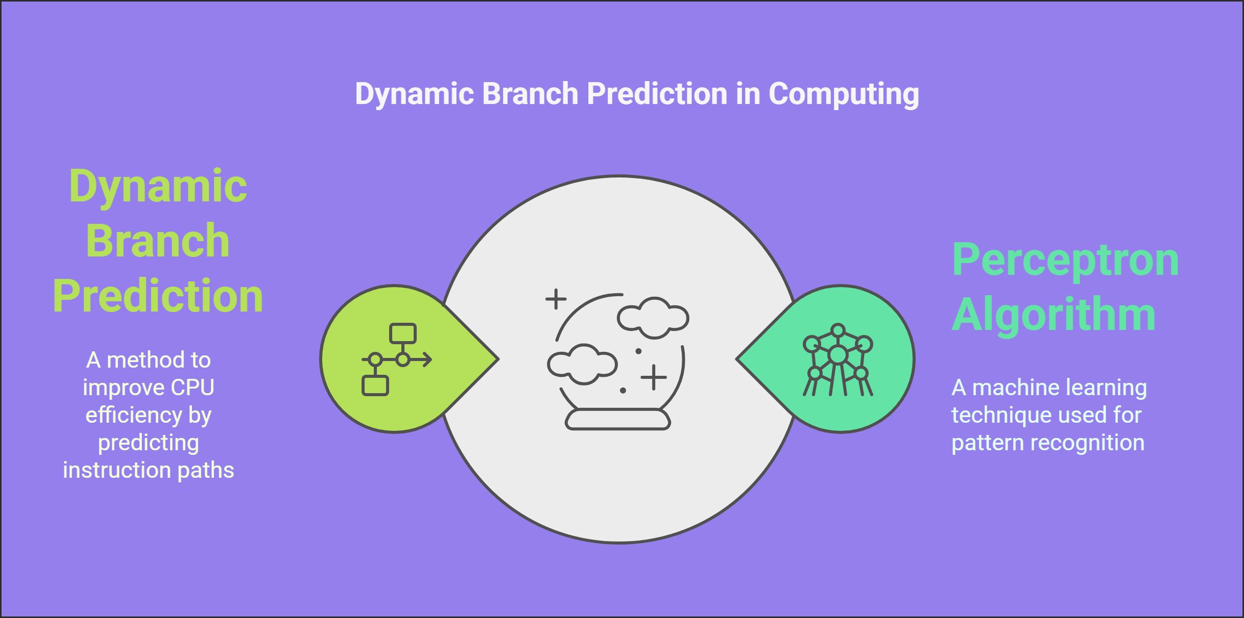
The power of communication

Slide 6
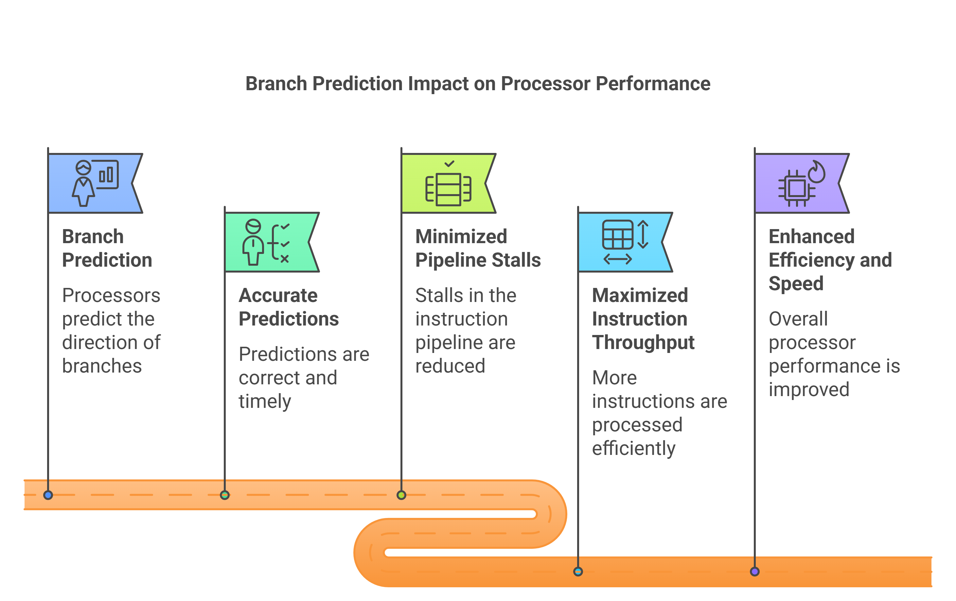

Slide 7
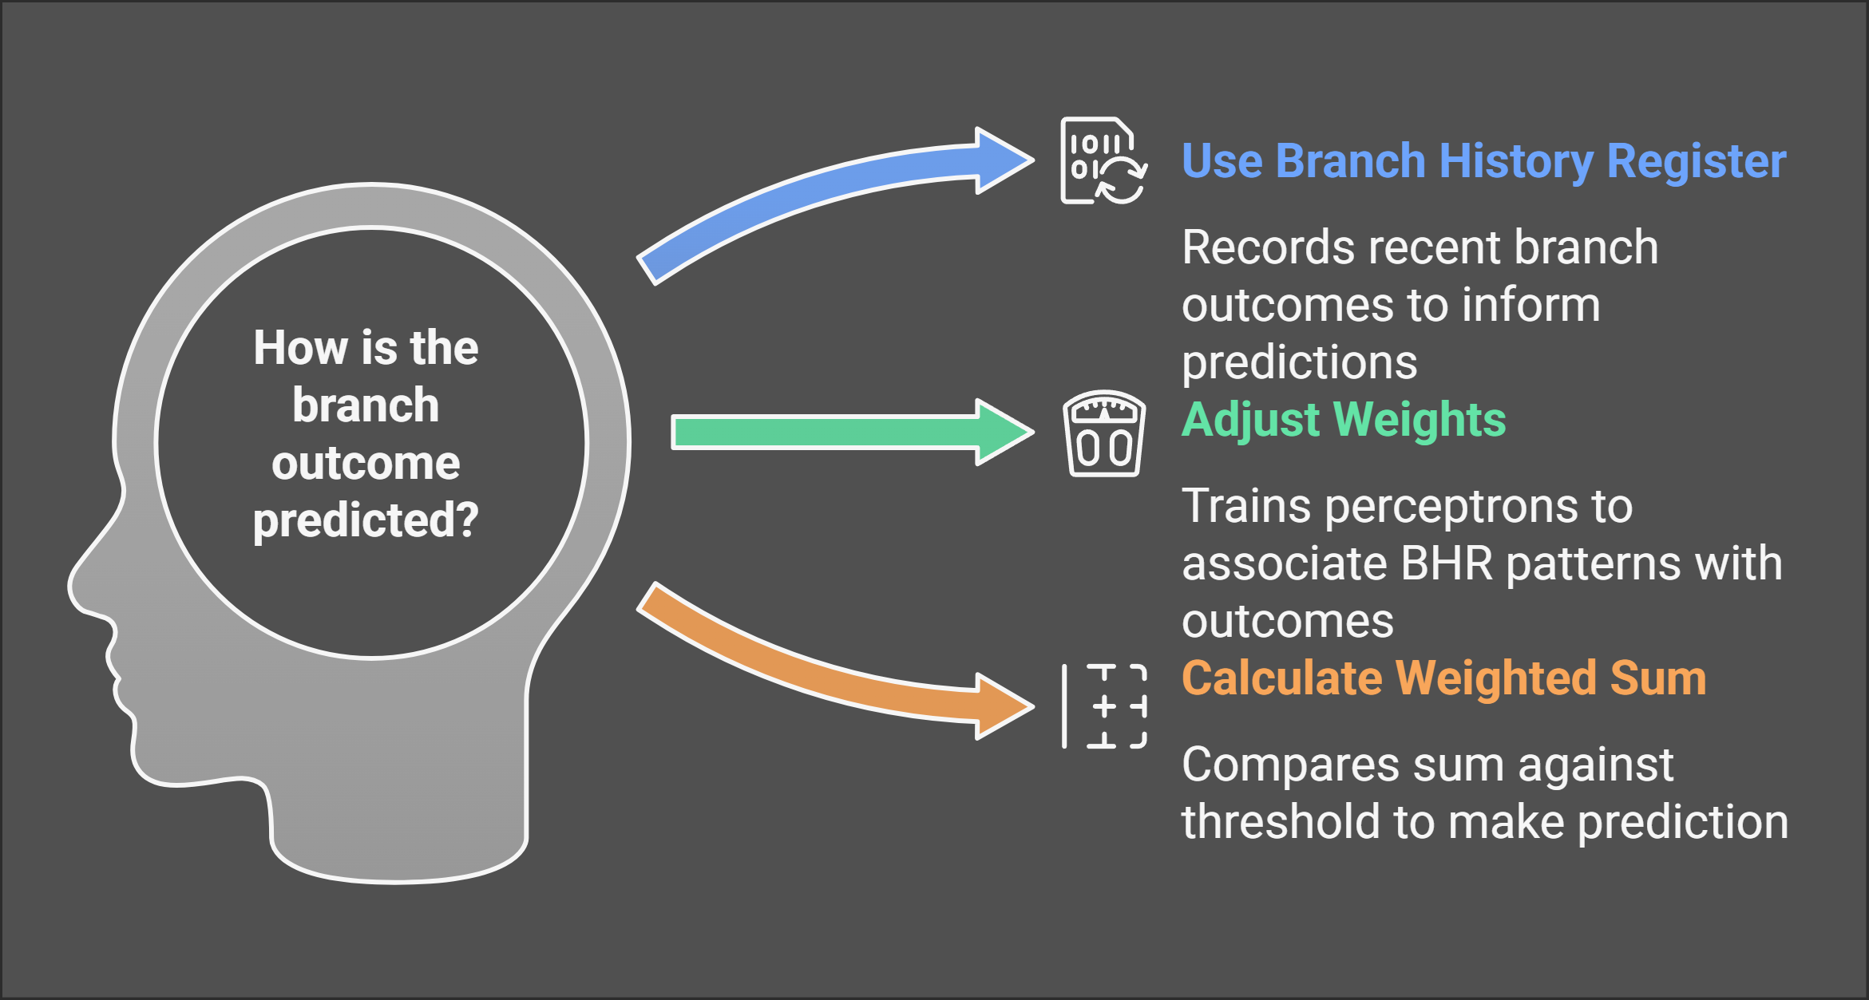

Slide 8
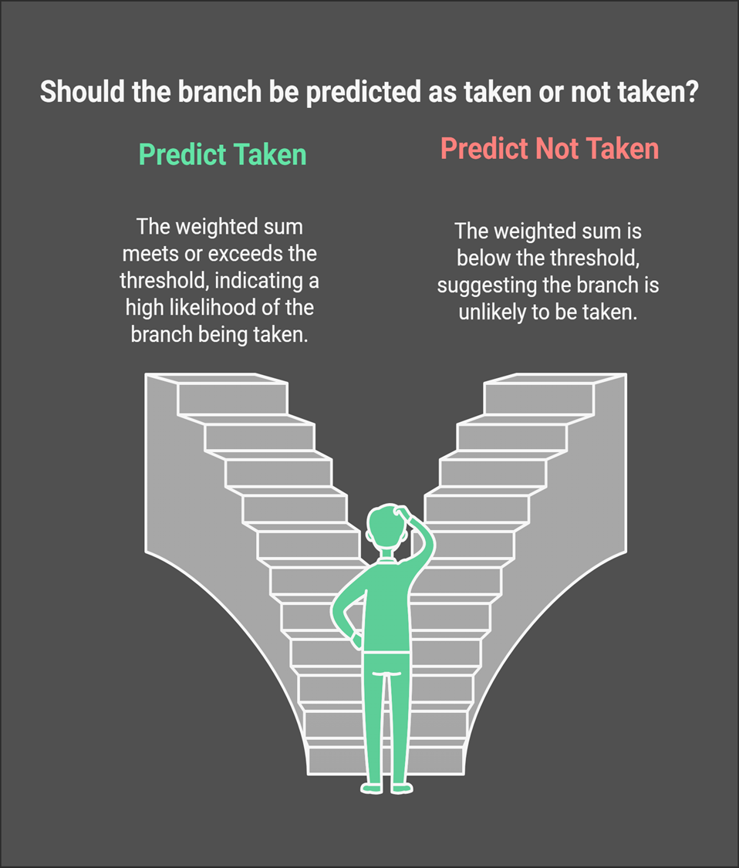
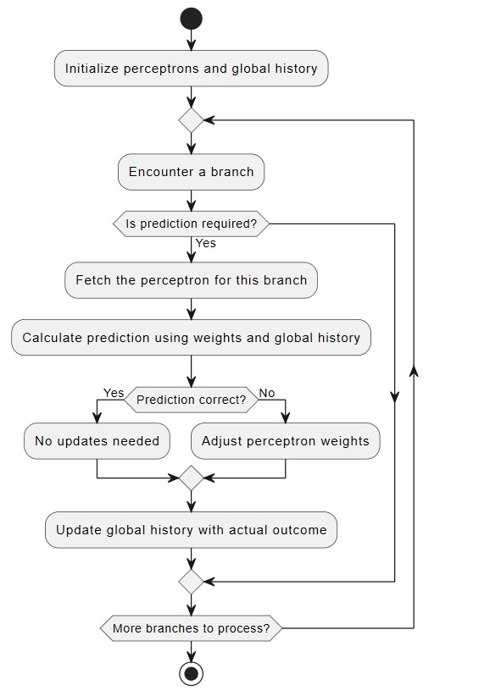

Slide 9

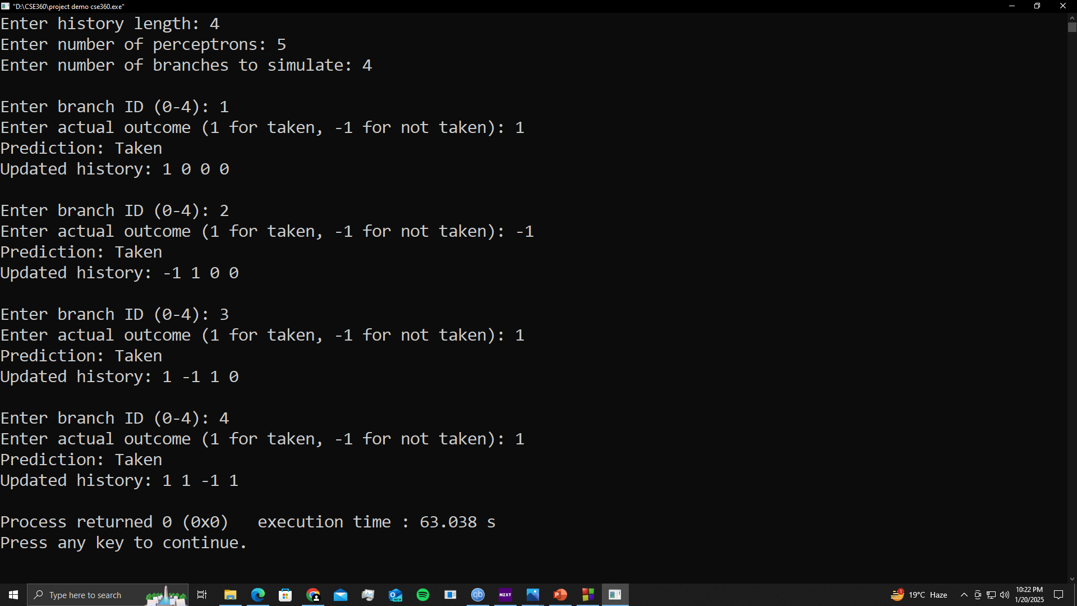

Slide 10
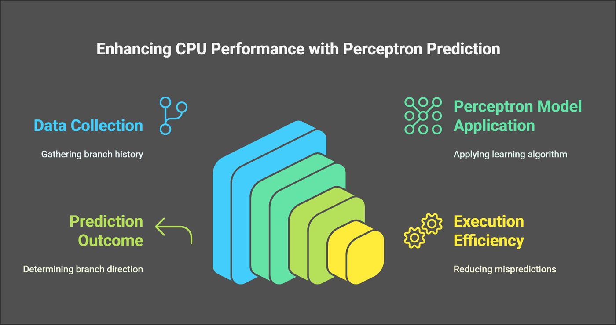
Engaging the audience
Advantages of Perceptrons:
Make eye contact with your audience to create a sense of intimacy and involvement
Weave relatable stories into your presentation using narratives that make your message memorable and impactful
Encourage questions and provide thoughtful responses to enhance audience participation
Use live polls or surveys to gather audience opinions, promoting engagement and making sure the audience feel involved

Slide 11
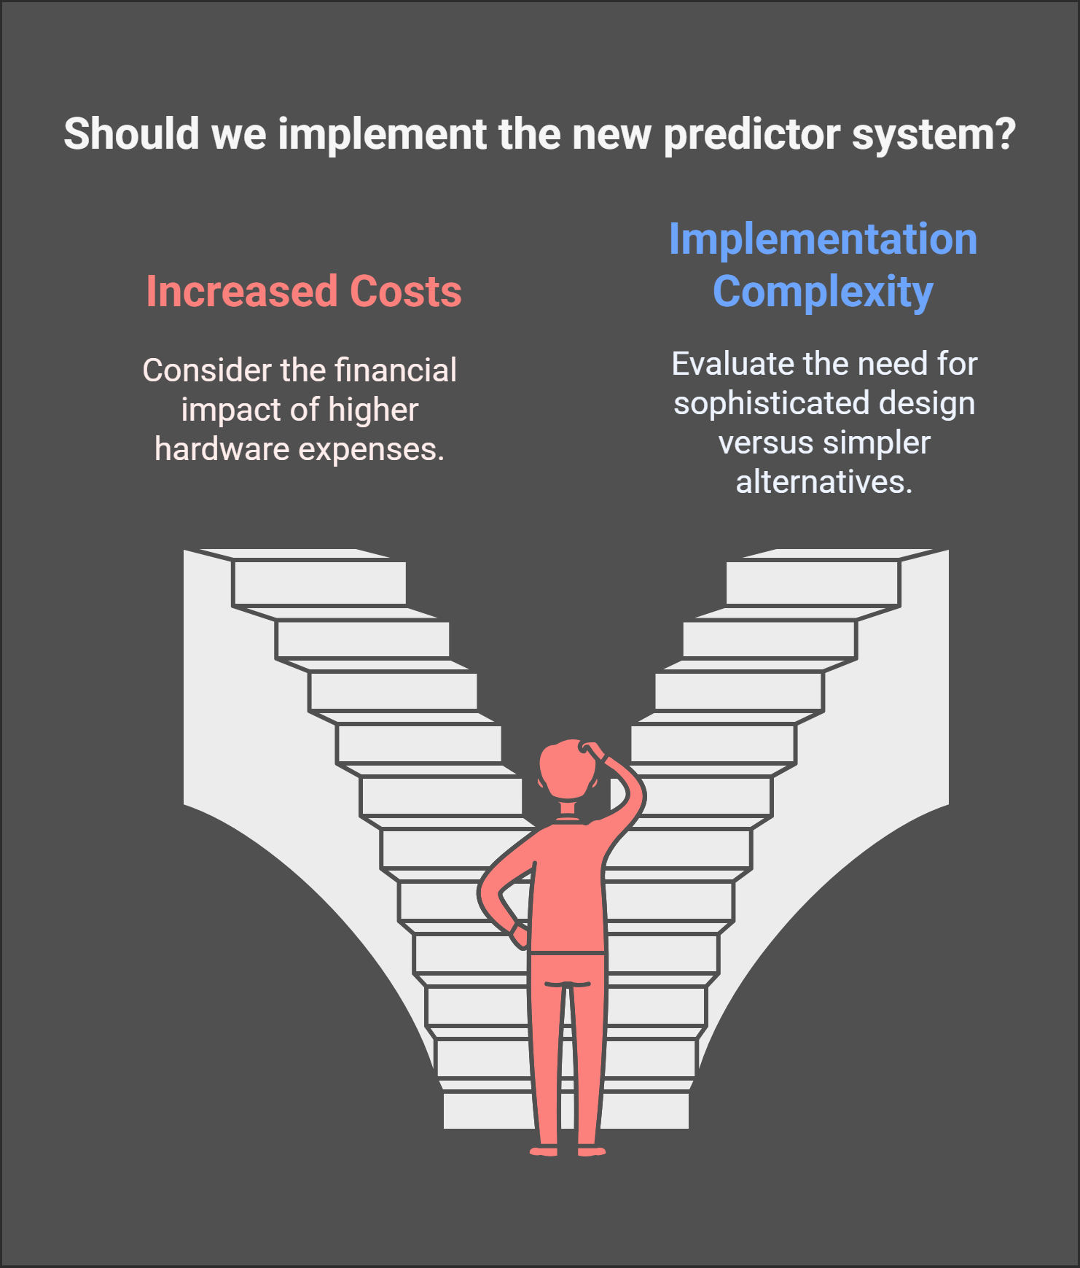
Challenges :
Increased hardware costs associated with weight storage and management.
Complexity of implementation

Slide 12
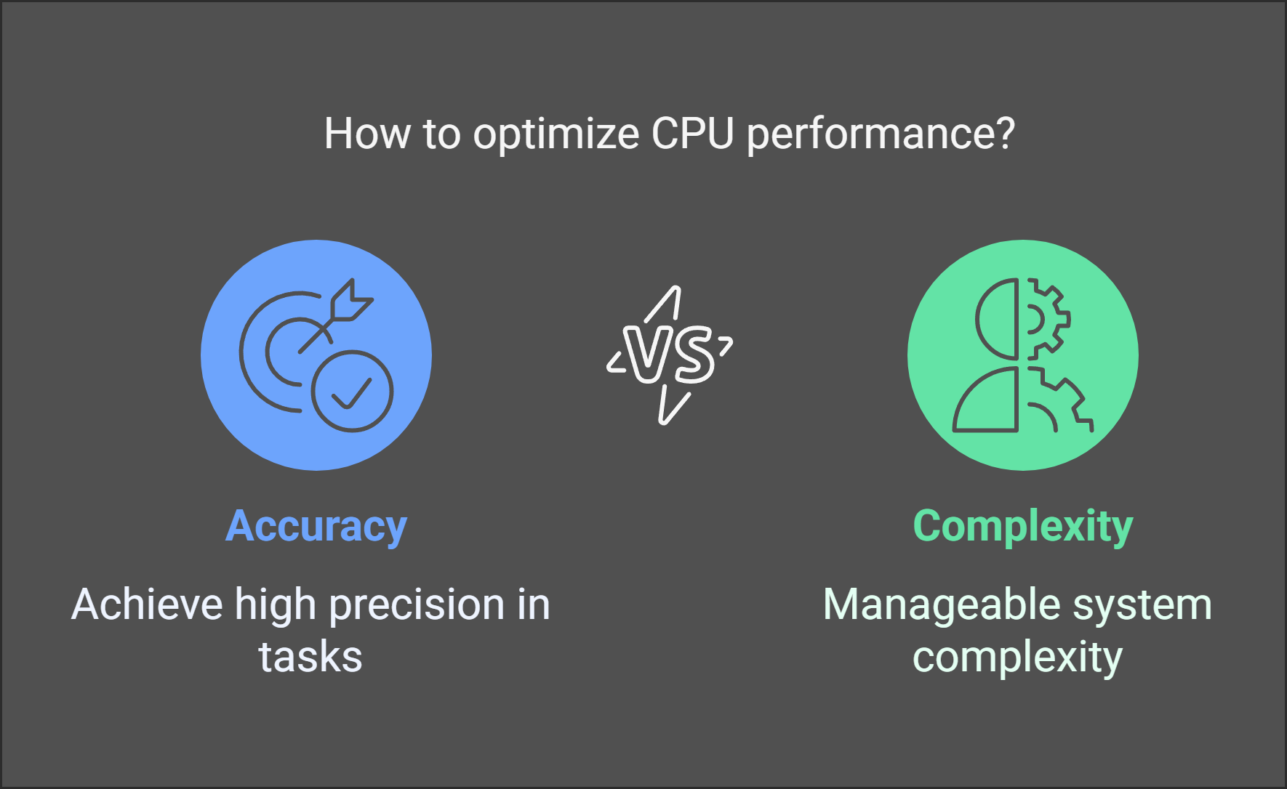
Conclusion :

Slide 13

Thank you

